Slide 1

Housekeeping
Module 6 – Culturally Competent Peer Support
Please mute yourself if you are not speaking.
Feel free to include your pronouns in your Zoom Name.
Use Zoom reaction tools, chat box, hands up, etc.
Be prepared to have video on at all times, as such, please be appropriately dressed and limit distractions.
Contribute to the conversations out loud and in the chat box.
Notes:
NOTE: housekeeping and expectations slides will be on the screen as folks enter the Zoom meeting
mar
Read out Housekeeping slide.

Slide 2
Expectations
Module 6 – Culturally Competent Peer Support
Arrive on time.
Help us create a confidential and non-judgemental space (no screenshots or recordings).
Please keep your phones on silent.
Avoid cross-talk and side-talk.
Learn from each person’s perspective.
Language - please bring new language to us as we recognize that language is ever-changing.
Have fun!
From the group:
Pause - When something is said during class that someone feels is important they can write pause in the chat to literally pause the conversation give them a minute to take a note about it. This could also work if a topic is moving too quickly.
Notes:
mar
Read out Expectations slide.

Slide 3
Culturally Competent Peer Support
Module 6
Notes:
Trainer Manual
Module 06: Culturally Competent Peer Support © 2023 PeerWorks
This training program is designed to be accessible to all trainers, and ensure that all participants receive the same quality of education regardless of specific trainers’ background and experience.
This manual is a living document and should be understood as a set of guidelines, not as a fixed script. Feel free to adapt the language to your style of presentation. We also recognize that language is always changing; please update terminology when necessary. The synchronous sessions should be dynamic, engaging experiences.
TRAINER
Welcomes everyone and states the topic of today’s module.

Slide 4
Land Acknowledgement
Module 6 – Culturally Competent Peer Support
Today I am joining you from the town of Agassiz, in the Fraser Valley, BC, in the shadow of Mount Cheam. As a visitor on this land, I would like to begin by acknowledging that I am on the traditional and unceded territory of the of the Cheam, Sts’ailes, Sq’éwlets and Seabird Island people . As a descendant of British and Irish settlers, I am committed to supporting reconciliation, and one step toward that is to learn about the history of the land and the original people wherever I go on Turtle Island.
Notes:
TRAINER’S LAND ACKNOWLEDGEMENT

Slide 5
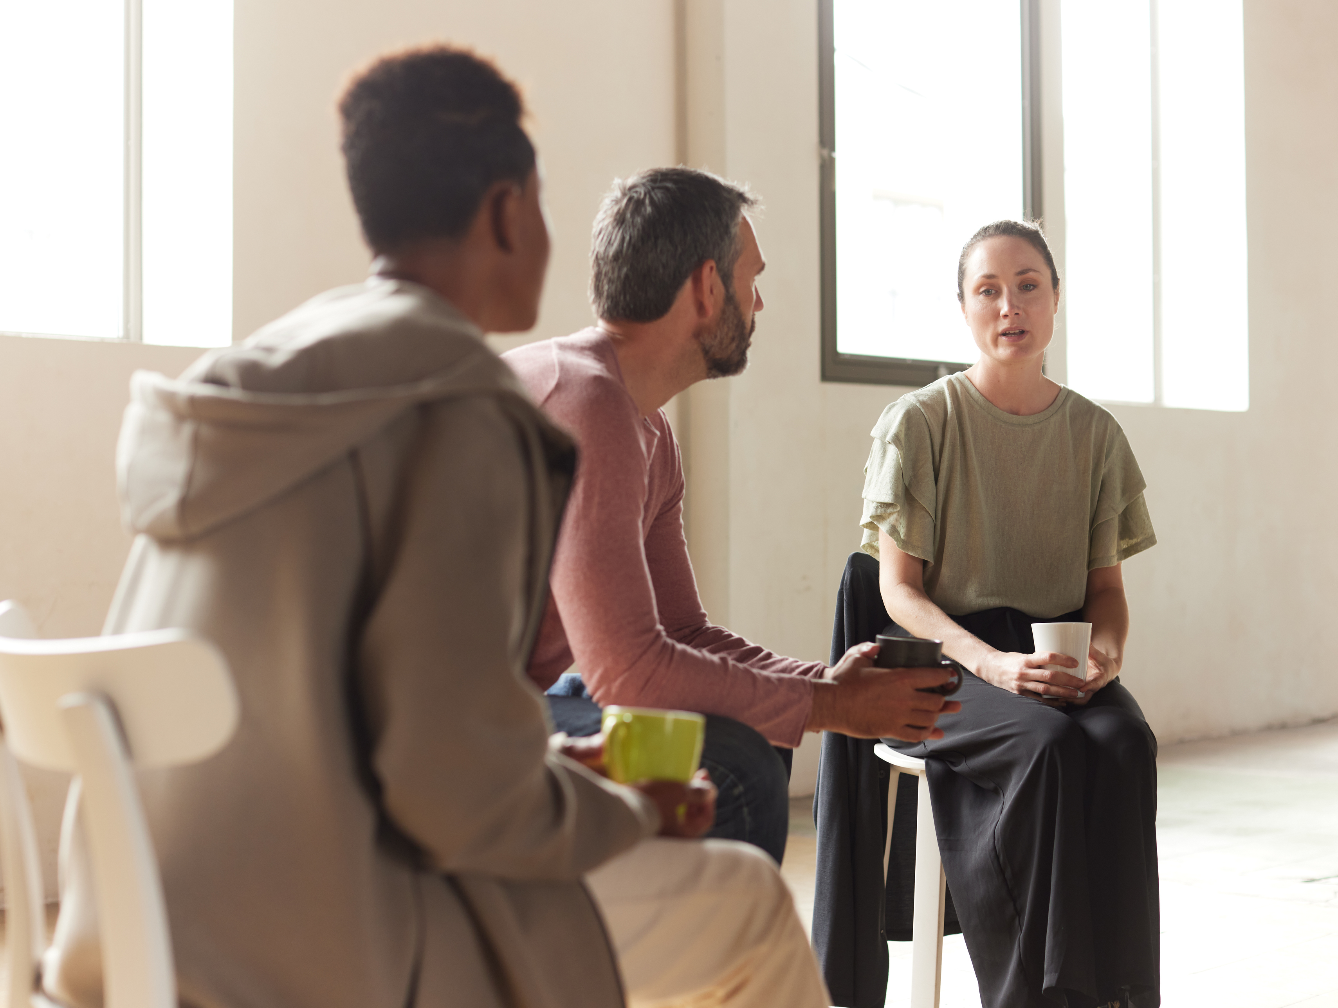
Module 6 – Culturally Competent Peer Support
What is your name?
What is your favourite meal?
Notes:
TRAINER
“What is your favourite meal?”
As the trainers, feel free to go first. Keep it brief and thank people for sharing. People often associate meals with their culture and community. This question is a way to get people to start thinking about their relationships to different communities.
Ask about the homework and if anyone wants to share any of their responses or their thoughts on the webinar.

Slide 6
Module Overview
Module 6 – Culturally Competent Peer Support
In Module 6 we will be discussing Culturally Competent Peer Support. We will be learning about the importance of anti-racism and creating inclusive, welcoming environments for Peers.
We will consider the meaning of community to a Peer we are intending to support. We will explore the influence of culture in the delivery of Peer Support services. We will also talk about the importance of Peer Supporters becoming familiar with the services and resources offered within our local communities.
Notes:
mar
Read the Module Overview and Learning Objectives out loud or invite a participant to read it out loud.

Slide 7
Learning Objectives
Module 6 – Culturally Competent Peer Support
Through the successful completion of Module 6 you will be able to:
Identify the elements of culturally competent Peer Support and describe how Peer Supporters can deepen their understandings of a Peer’s community.
Start developing your culturally competent practice.
Become familiar with local community resources and identify strategies to further this knowledge.
Notes:
mar
Read the Module Overview and Learning Objectives out loud or invite a participant to read it out loud.

Slide 8
Guidelines for Learning about Other Cultures and Communities
Module 6 – Culturally Competent Peer Support
Strive for intellectual/cultural humility: we aren’t the authorities on other cultures and communities, we need to listen to people from those groups.
Recognize the difference between opinions and informed knowledge.
Recognize how your own social positionality (such as your race, class, gender, sexuality, ability-status) informs your perspectives and reactions.
“Leaning in: A student’s guide to engaging constructively with social justice content”
- Robin DiAngelo and Özlem Sensoy
Notes:
TRAINER
“These are a few guidelines to inform our discussion about cultural competency. We are here to listen and support people. We don’t have to understand everything that they are going through in order to offer that support, but we do have to practice being non-judgmental and acknowledge that we don’t know everything.”
Cultural humility might be a term that people are not familiar with. It relates back to the cornerstone of Self-awareness. It is about reflecting on our own awareness and biases, as well as an engagement with life-long learning. Cultural humility is about reflecting on your beliefs and learning from others who know more than you.

Slide 9
Module 6 – Culturally Competent Peer Support
Diversity is relational. No individual person is diverse, but we can have a diverse community or organization. This means that our community includes a large number of perspectives, experiences and identities. Diversity refers to the unique characteristics that all of us possess, both distinguishing us as individuals and identifying us as belonging to different groups. Diversity embraces the richness inherent in people’s race, ethnicity, socio-economic status, gender, religion, sexual orientation, family identification, immigration status, functional ability and age.
Inclusion It isn’t enough to have a variety of people involved, they need to feel welcomed and respected. This is what is meant by inclusion. Inclusion involves designing our space in order to make everyone feel valued and have their needs met.
Notes:
TRAINER
Read out the definition for diversity. This first part might be fairly straightforward for most people. Make sure to reiterate that an individual cannot be diverse. When we refer to individuals as “diverse” we make them feel as though there is a “normal” and that they are not it. They are abnormal or “other.”
Read out the definition for inclusion. It can be hard to understand the distinction between the two, as they are often used together. An example might help everyone understand:
Example: “Think of your workplace as a dinner table. Diversity says that everyone is invited to the table regardless of dietary preference or restrictions. However, just because someone is invited to the table, does not mean that they are welcomed or that dinner has been made accessible to them. The only meal provided might be a pepperoni pizza. This isn’t a meal that vegetarians, vegans, gluten-free people or anyone that keeps kosher or halal can eat. Inclusion says, it’s not enough to invite us to the table, you have to make sure that there is something there that we can eat and that we feel welcomed to join.”

Slide 10
“Intersectionality is a lens through which you can see where power comes and collides, where it interlocks and intersects. It’s not simply that there’s a race problem here, a gender problem here, and a class or LBGTQ problem there.”
-From “the Intersectionality Wars”, a 2019 Vox profile of Kimberlé Crenshaw by Jane Coasten.
Professor Kimberlé Crenshaw coined the term “intersectionality” in 1989.
Notes:
TRAINER
Read the quote on the slide. Intersectionality can be a hard term for people to grasp. It might help to refer back to the dinner table example.
“When we were discussing the dinner table, we mentioned the possibility of there being people with different dietary restrictions or preferences, such as vegetarian, gluten-free or kosher. However, some people might fit into several of these categories. They might be vegetarian AND gluten-free. They might keep kosher, AND be lactose-intolerant. Intersectionality reminds us of this.
In terms of real-world application, Kimberlie Crenshaw first introduced the term to describe different lived experiences. Gender and race can impact these experiences. So for example, while a white man and a white woman can have different experiences based on their gender, a white man and a black woman would have different experiences based on their gender AND race. Similarly, a blind Asian man would have a different experience based on his race AND ability. Intersectionality is acknowledging that these different identities (gender, race, sex, ability, etc) intersect and impact our experiences.”
Part of these different experiences has to do with privilege. We live in an unjust society that gives advantages to certain groups of people. This was brought up in our discussion of inequity in Module 3. You might also be familiar with the term “white privilege.” “White privilege” recognizes that we live in a racist society and white people are afforded certain advantages based on the colour of their skin. This isn’t the only kind of privilege there is. There are privileges based on other identities such as race/gender/sexuality/ability et cetera. As people with lived experiences of mental health and addiction we may have experienced discrimination and stigma. Recognizing privilege is recognizing that those experiences can also intersect with racial/sexual/class discrimination.

Slide 11
Small Group Activity
Module 6 – Culturally Competent Peer Support
First make a list of 3-5 communities that you belong to.
Then break into groups of two or three people. See if you have any other communities in common.
Choose a community you don’t have in common and ask your Peer how familiar they are with it.
Do the same for a community your Peer is a part of with which you are not familiar.
Discuss with your partner how easy or difficult would it be for someone outside of these communities to enter them?
What are ways that you or your partner could become acquainted with this unfamiliar community?
Notes:
mar
“A community can be described as a group of people who share a connection, have something in common. We can consider ourselves as a community of Peers that share the experience of mental health and/or addictions. Other points of connection within communities include shared interests, geography, roles, or origins to name a few.
Aside from being connected with this community, name or describe some other communities that you are affiliated with. What is it that you have in common? What is your point or points of connection?”
Small group activity. Read out the instructions and separate the participants into break-out rooms. After 10-15 minutes, reconvene and ask one person from each group to share the main points that came up in discussion.
Examples can be: immigrant communities, religious communities, people with a shared hobby (such as sci fi or knitting), geographic community, shared dietary preferences (such as vegetarians or paleo diet), et cetera.
At this point you should be about halfway through the allotted time. Some people might need a bio break

Slide 12
Cultural Competency is the ability to interact effectively and comfortably with people from different cultures.
Module 6 – Culturally Competent Peer Support
It involves four aspects:
Becoming aware of your own beliefs, prejudices and discriminatory behavior. (This has also been termed as cultural humility.)
Changing your beliefs and attitudes (if necessary) about people who differ from you in terms of race, ethnicity, culture, sexuality and other characteristics.
Gaining knowledge about beliefs and practices in different cultures.
Developing communication skills to interact sensitively with diverse individuals.
Notes:
TRAINER
Invite someone to read the slide on cultural competency. Draw attention to the language in the definition: competent not expert. It isn’t necessary to be an expert on other cultures, instead what cultural competency promotes is a commitment to learning and listening.

Slide 13
You are assigned to work with a peer from a culture that is very different from your own.
Module 6 – Culturally Competent Peer Support
Decline the assignment because you have nothing in common with them.
Meet with the service recipient like you usually would and don’t talk about your cultural differences unless they bring it up.
Focus on recovery because culture has nothing to do with mental illness.
Acknowledge your cultural differences and ask the service recipient if she would like to discuss them.
Notes:
TRAINER
Scenario to be done together as a group. Invite someone to read out the scenario. You can also create a poll for people to vote on the response that they would use.
Again, this is a scenario where context matters. The Peer Support relationship reflects the people within the relationship. You might bring up the cultural differences and your peer might suggest that it doesn’t matter to them, and that they would prefer to focus on recovery. Another peer might state that their recovery cannot be separated from their cultural experiences.
MAR
Poll question: Do you know about the differences between equity and equality?
Yes I do
No I don't
I think I do

Slide 14
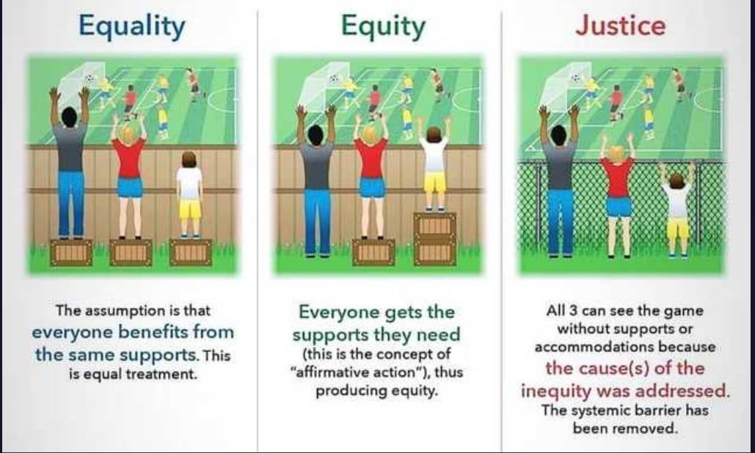
Notes:
TRAINER
The next slide introduces terminology that we are hearing more of lately: Equity, Equality and Justice. Many organizations are hiring Diversity Experts or Experts in the field of Equity, Diversity and Inclusion or Anti-Oppression, and so it’s good to have a working knowledge of these terms.
This cartoon can also help to visualize the difference between these seemingly similar words.
“When we treat everyone equally, we treat everyone the same, but when we treat everyone equitably, we focus on individualistic needs. In a diverse workplace, differences exist, and people require support in different ways. Equity asks us to acknowledge that everyone has different needs, experiences, and opportunities.
In the context of Peer Support, this might look like acknowledging that not everyone has the same access to mental health resources or the same supports.
In Module 3, we talked about the history of Peer Support and how early Peer Supporters were activity involved in working against power imbalances in mental health organizations. This is the work of anti-oppression. Anti-oppression work is recognizing social and economic imbalances in society and working to correct them. This can be big work within organizations or personal work, where we reflect on our own biases and opinions. While we may not individually be racist/sexist/classist, we might be upholding oppressive power dynamics without realizing it.

Slide 15

Golden Rule vs. The Platinum Rule
Module 6 – Culturally Competent Peer Support
Golden rule: treat others like you would like to be treated.
Platinum rule: treat others like they would like to be treated.
Notes:
TRAINER
Read slide out loud.

Slide 16
Video to be played by Training Coordinator

Slide 17
Unconscious Bias and Microaggressions
Module 6 – Culturally Competent Peer Support
Unconscious Bias: also known as implicit bias, is a bias that someone might not be aware they have.
Example: assuming that an older person is less tech-savvy than a younger person, because of their age, or assuming that someone likes children, because they are a woman.
Microaggressions: subtle, unconscious or indirect forms of discrimination against a marginalized group.
Notes:
TRAINER
Ask a participant to read out the definitions of unconscious bias and microaggressions, as well as the example.

Slide 18
“I didn’t think you would be interested in reading.”
“I never would have guessed you were transgender!”
“Where are you really from?”
“You’re a teacher? But you look so young!”
“Your name is so exotic.”
Notes:
TRAINER
*NOTE slide is animated. Each example comes up one at a time.
This slide is full of examples of microagressions. Each quote will pop up as you click next, as they are individually animated. Go through one at a time. Ask people to discuss how these phrases/sentences are offensive.
Here are some notes to bring up:
“I didn’t think you would be interested in reading.”
Suggests that the person doesn’t look smart or perhaps uneducated. This is particularly harmful when the person on the receiving end of the statement is a minority in the workplace.
“I never would have guessed you were transgender!”
Suggests that there is something wrong or unusual with looking transgender and that people should try to look cisgender. Often said with the tone of a compliment, which makes the person on the receiving end feel even more uncomfortable.
“Where are you really from?”
Suggests that the person couldn’t possibly be from Canada/Ontario. Can make a person feel unwelcomed or as though they stand out. Positions the person as an outsider.
“You’re a teacher? But you look so young!”
Suggests that the person isn’t qualified for their job. These types of phrases are often directed to women. It also suggests that a person’s appearance is directly connected to their experience/talents/skills.
“Your name is so exotic.”
As with “where are you really from?” this makes a person feel as though they are ‘other’ and do not belong to the rest of the group. This name might be very common in their community/culture.

Slide 19
Resources
Module 6 – Culturally Competent Peer Support
PeerWorks Webinar: Ten Ways to Rock the Rainbow
PeerWorks Webinar: Indigenous Peer Support
Kimberlé Crenshaw’s TED Talk “The Urgency of Intersectionality” (2016 18 min 40 sec)
PeerWorks Blog Posts:
“In an Ongoing Pandemic Affordable Access to Technology is a Public Health Issue”
“Black Mental Health Matters: Resources for Learning and Change.”
“Addressing the Rise of Anti-Asian Racism and Supporting Asian-Canadian Community Members.”
Links for all resources are in your handbook.
Notes:
mar
Go through the resources available in the participant homework handout. “Ten Ways to Rock the Rainbow” is about gender and sexual diversity. Some people might not be familiar with the difference between gender and sexuality.

Slide 20
Gender Identity vs Sexual Orientation
Module 6 – Culturally Competent Peer Support
Sexual orientation describes the way a person feels toward people of a particular (or more than one) gender both physically and emotionally.
Examples of sexual orientation include: heterosexual, bisexual, homosexual, asexual, queer, etc.
Gender identity describes the way a person feels about their gender — including their body — and the ways they feel they’re expected to behave within that body.
Examples of gender identity include: cisgender, transgender, and nonbinary.
Notes:
TRAINER
Ask the group how familiar they are with these terms, and if they can explain the difference. If the group is not familiar, take some time to go through the next few slides, which define common gender and sexuality related terminology.

Slide 21
Module 6 – Culturally Competent Peer Support
L – Lesbian: a female-identified person who is physically and emotionally attracted to other females.
G – Gay: a male-identified person who is physically and emotionally attracted to other males. Gay is also used as a broad term to describe people attracted to someone of the same gender.
B – Bisexual/Bi: a person who is physically and emotionally attracted to people of more than one gender and who identifies as bisexual (bi).

Slide 22
Module 6 – Culturally Competent Peer Support
T – Transgender/Trans: transgender (trans) is a term used by people who identify with a gender that is different from the gender they were assigned at birth. People whose gender identity falls outside of the gender binary (the idea that there are only two genders — male and female) may also call themselves trans. Since trans is a word used to describe identity, a person has to identify with the term (believe it’s the best way to describe themselves) for it to be applicable. No one else can decide a person is or isn’t trans. Other terms to describe gender identity that may be preferred by some people include genderqueer, gender fluid and androgynous.
Trans is not a sexual orientation — it’s a gender identity. “T” (for transgender/trans) is grouped with the sexual orientations in LGBTQ2S+ for many reasons, including shared civil and human rights activism and similar experiences of discrimination.

Slide 23
Module 6 – Culturally Competent Peer Support
Q – Queer: queer is a broad term that includes all sexual orientations and gender identities within the LGBTQ2S+ community, including those who don’t identify with any other identity in LGBTQ2S+. The term queer can be both positive and negative. Historically, queer was used as an insult, but it has been reclaimed by the LGBTQ2S+ community to self-identify in a positive way.
Q – Questioning: some people may feel unsure about their sexual orientation and/or gender identity. They may describe themselves as questioning. They may be questioning until they identify with a particular identity or continue to be questioning throughout their lives.
Two-Spirit (2 Spirit or 2S): a person with both a feminine and a masculine spirit living in the same body. It’s an important term within some Indigenous cultures and some Indigenous people use it to describe their sexual orientation, gender identity and/or spiritual identity.

Slide 24
Homework
Module 6 – Culturally Competent Peer Support
For Next Time:
Research a community resource that is local/accessible to you. Learn about the services that this resource offers and take notes that include the information on how to connect to this resource.
E-mail your resource to the trainers.
You can also add them to the Google document yourself; the link is in your handbook.
Notes:
mar
Go through the homework for next time, thank everyone for their participation, and ask if there are any final comments or questions.

Slide 25
Thank You
Notes:
TRAINER
Thank everyone for their time and ask if anyone has any final comments or questions that they want to bring forward.

